Slide 2
Minor Project – II Title of the project - Object Detection
MEMBER’S NAME | ROLL NUMBER | SAP ID | BRANCH
Tushar Goyal | R103218163 | 500067581 | BAO
Vinay | R103218167 | 500068489 | BAO
Sourabh Verma | R103218156 | 500069030 | BAO
Shivam Sahu | R103218140 | 500069419 | BAO
Under the guidance of
Dr. Bhupesh Kumar Dewangan

Slide 3
CONTENTS
Abstract
Introduction
Motivation
Literature Review
Problem Statement
Objective
Methodology
Flow Chart, Algorithm & Implementation
Progress (results )
References

Slide 4
ABSTRACT
Object detection is a well-known computer technology connected with computer vision and digital image processing (DIP) that focuses on detecting objects or its instances of a certain class (such as humans, flowers, animals) in digital images and videos, image. Object detection and digital image processing has been employed in number of areas such as pattern recognition, remote sensing-sharpening, color and video processing and medical. Object detection technology has been driven by an increasing processing power available in software and hardware. This work present an developed application for image processing and multiple objects detection based on OpenCV libraries.
Keywords: Object Detection, Image processing, computer vision, edge detector.

Slide 5
INTRODUCTION
Object detection is a computer vision technique that works to identify and locate objects within an image or video.
Object detection is widely used in medical diagnosis such as detecting breaks in bones, cell abnormalities, and other issues depending on medical images such as CAT scans, MRI images, X-rays, sonograms, and other images.
It has been proved that lung cancer is the topmost cause of cancer death in men and women worldwide. So, image processing in OpenCV can be helpful for more accurate detection of tumor in CT images of lungs.
OpenCV is the huge open-source library for computer vision, machine learning, and image processing and now it plays a major role in real-time operation which is very important in today’s systems.

Slide 6
Motivation
What is the history of the problem?
About 85% male and 75% females are suffering from lung cancer due to cigarette smoking.
The general survival rate of people suffering from lung cancer is 63%.
Is the problem already solved? What is done now?
An X-ray image of your lungs may reveal an abnormal mass or nodule. A CT scan can reveal small lesions in your lungs that might not be detected on an X-ray.
Surgery, radiation treatment, and chemotherapy have been utilized as a part of the treatment of lung tumour.
Are there any similar systems or solutions to the one you propose?
MRI (Magnetic Resonance Imaging) is another detection method used for creation of 2-D or 3-D images which too have trade-offs depending upon the style of acquisition. According to the researchers and past studies suggest that MRIs have high detection rate for visually invasive cancer and sensitivity rate higher than mammography and it offers better resolution[3].

Slide 7
Motivation(continued)
Are there possible improvements to current solutions?
Automated Object-detection can be used to detect the abnormal mass or nodules from the CT lung Images more accurately at an early stage so that quick and more efficient treatment can be given to the patients.

Slide 8
Literature Review
The Object Detection method is used because of its strong adaptability and robustness, however, the detection speed needs to be improved, because it requires testing all possible windows by exhaustive search and has high computational complexity[1].
The detection and diagnosis of lung cancer can be processed on three basic stages which are pre-processing, segmentation and finally followed by post-processing. The CT scan image is pre-processed to remove Gaussian white noise using non- local mean filter technique[3].
Lung segmentation is the most crucial and challenging task in a CAD system as it provides the search space for detecting nodules. In the nodule detection stage, the candidate nodules are identified by enhancing the suspected areas and suppressing the other structures like blood vessels. This step reduces the search space for nodule detection[2].
Canny’s three edge detection criteria are as follows [2]:
Good detection. There should be a low probability of failing to mark true edge points, and low probability of falsely marking non edged points. The signal-to-noise ratio should be as high as possible.
Good localization. The points marked as edge points by the operator should approximate to the center of the real edge as much as possible.
Low spurious response. Single edge produces fewer multiple responses, and false boundary responses are suppressed to the maximum.

Slide 9
PROBLEM STATEMENT
The early detection and diagnosis of nodules in CT image are among the most challenging clinical tasks performed by radiologists .
X-RAY mammography misses the presence of tissue abnormality 15% of the time.
Radiologists can miss up to 25% of lung nodules in chest radiographs due to the background anatomy of the lungs which can hide the nodules.
Although the Magnetic resonance imaging (MRI)can detect the lung edge, unfortunately, the final edges lines produce is still unsatisfied[3].

Slide 10
OBJECTIVES
To develop a computer aided diagnosis system for finding the early cancerous nodules using the lung CT images and also find the number of nodules and area of nodules.
Sub-Objectives:
To pass the image that is to be analyzed through the image processing in OpenCV for further diagnosis.
An automated lung cancer detection system using image processing is used to classify the present of lung cancer in an CT- images.
The diagnosis system then examines the CT image to extract features like number of abnormal cells ,length of tumor and maximum area of a tumor.

Slide 11
METHODOLOGY
IMAGE PRE-PROCESSING
COMPUTER VISION
CANNY EDGE DETECTION
IMAGE SEGMENTATION
LUNG SEGMENTATION
FEATURE EXTRACTION
RESULT ANALYSIS
Amount of tumor cells present.
Total Area and Length affected

Slide 12
CANNY EDGE DETECTION
Gaussian Filter
Finding Intensity Gradient
Non-maximum Suppression
Hysteresis Thresholding
TO REMOVE NOISE
Image is then filtered with a Sobel kernel in both horizontal and vertical direction
A full scan of image is done to remove any unwanted pixels which may not constitute the edge
This stage decides which are all edges are really edges and which are not.

Slide 13
LUNG SEGMENTATION
The aim of medical image segmentation is to extract quantitative information (eg, volumetric data, morphometric data, textural patterns–related information) with regard to an organ of interest or a lesion within the organ.[4]
The computer-based process of identifying the boundaries of lung from surrounding thoracic tissue on CT images, which is called segmentation, is a vital step in radiologic pulmonary image analysis.
The currently available segmentation methods can be divided into five major classes: (a) thresholding-based, (b) region-based, (c) shape-based, (d) neighboring anatomy–guided, and (e) machine learning–based methods.[5]
We have applied Thresholding-Based Method for Segmentation.

Slide 14
LUNG SEGMENTATION(continued)
Five Major Classes of CT Lung Segmentation Methods [5]:
THRESHOLDING-Based
REGION-Based
SHAPE-Based
Neighboring
Anatomy-Guided
MACHINE LEARNING-Based
Identification and segmentation of well-defined normal structures and isolated lesions such as tumors, cavities and nodules
Normal structures, regions with minimal notices , minimal abnormalities
Also called atlas-based or model-based
Abnormal pathologic condition that defy segmentation of normal anatomy
Identification and Classification of pleural effusions or atelectasis.
Delineation of pathologic conditions with signature textured patterns such as GGO , consolidation and crazy-paving patterns

Slide 15
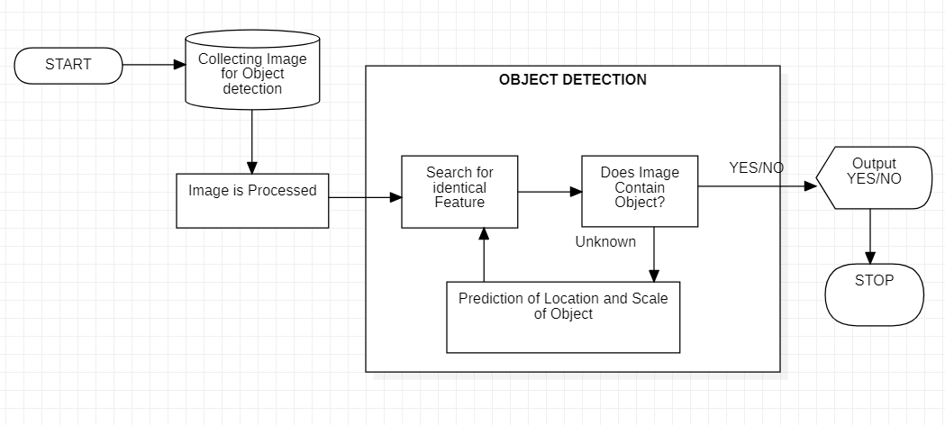
Flow Chart, Algorithm & Implementation
FIG.1. BASIC WORK FLOW MODEL OF OBJECT DETECTION

Slide 16
ALGORITHM AND IMPLEMENTATION
Start
Canny-Edge detection is applied for finding Lung Edges
Lung is segmented using Threshold-Based method using Canny
IMAGE PRE-PROCESSING
FEATURE EXTRACTION
Categorizing the tumors on the basis of their length and area
Displaying diagnosis results
.Load lungs CT Image Pixels
Finding Contours , in our case it is tumors.
Also Finding features like areas and length of tumors
Convert Image Into Gray
Applying Filter it blurs the image using Normalized box filter
Keeping our Focus on Lung Only
Gathering DATASET
APPLYING EDGE DETECTION
DISPLAYING RESULTS
END

Slide 17
IMPLEMENTATION (continued)
CANNY EDGE DETECTION PSEUDOCODE
START
Input image to be processed.
Load the Opencv library for the canny process.
Reads the image from the file and saves it to the matrix object.
Read the image.
Create an empty matrix to save the processed image.
Apply the canny function to detect edges.
Imgproc.Canny (source, dest, 100, 200, 3);
Imgproc.Canny (an object representing the source (input image) for this operation, a Mat
object representing the destination (edge) for this operation, a double type variable
representing the first threshold for a hysteration procedure, a double type variable
representing a second threshold for a hysterization procedure) ;
Create and save image processing results.
END

Slide 18
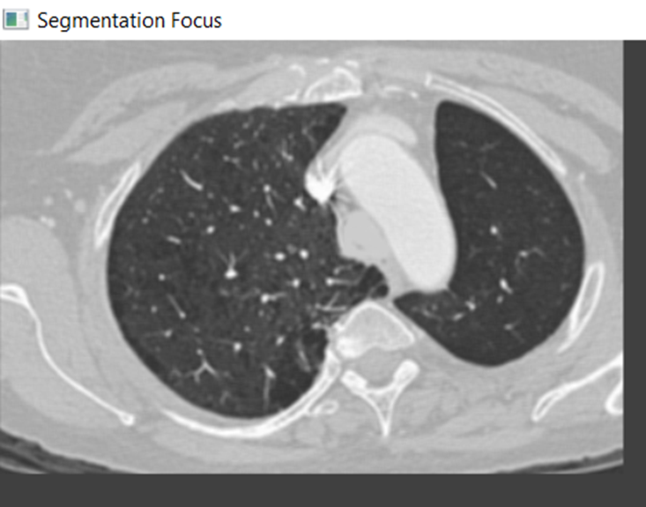
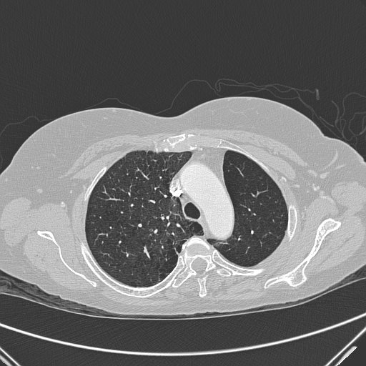
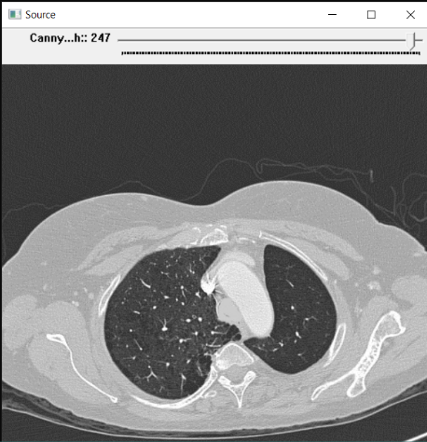
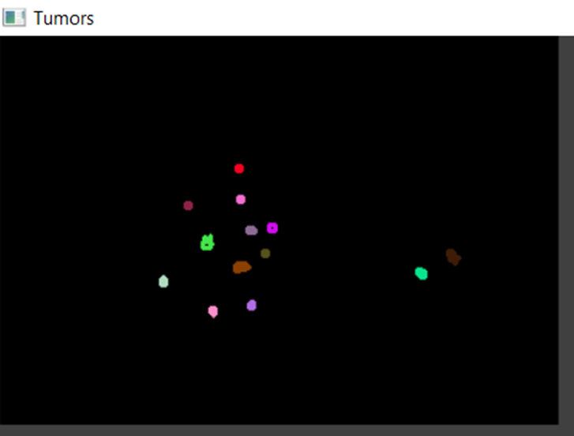
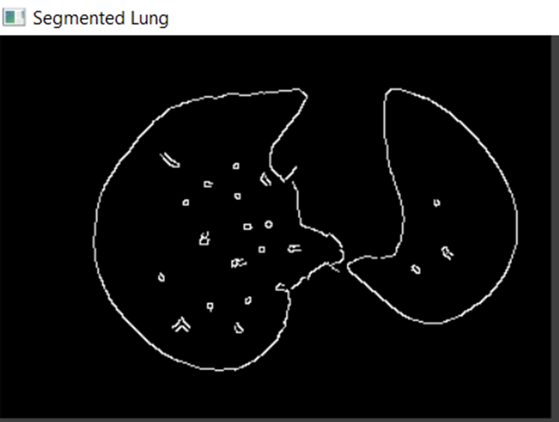
RESULTS
DATASET : https://wiki.cancerimagingarchive.net/pages/viewpage.action?pageId=70224216

Slide 19
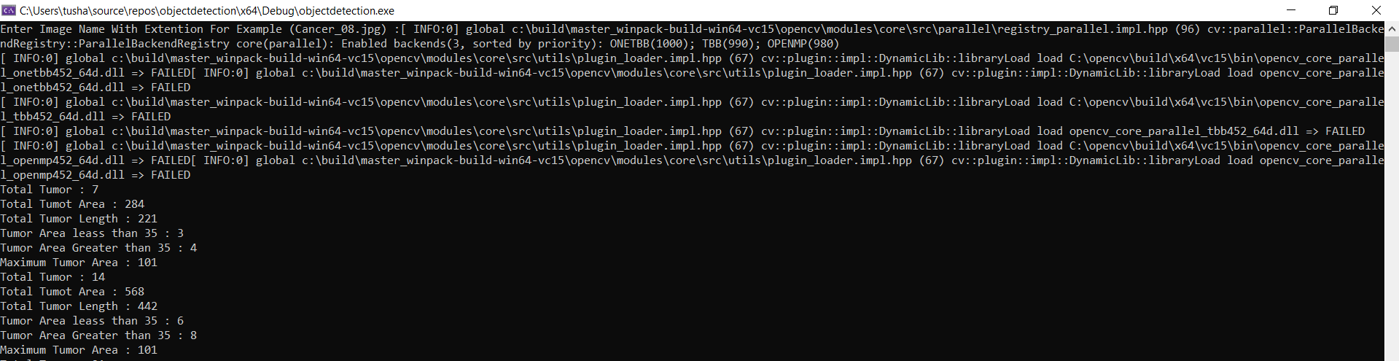
RESULTS

Slide 20
REFERENCES
[1] G.Niranjana, Dr.M.Ponnavaikko,” A Review on Image Processing Methods in Detecting Lung Cancer using CT Images”, 2017 International Conference on Technical Advancements in Computers and Communications, 978-1-5090-4797-0/17-2017 IEEE.
[2]J. Zhang (Ed.): ICAIC 2011, Part V, CCIS 228, pp. 102–108, 2011.© Springer-Verlag Berlin Heidelberg 2011
[3] Sowjanya M. N., Stafford Michahial, Mahanthesha , Nagalakshmi T. S. ,” Lung Cancer Detection in Chest X - Ray Image”, G.S.S.S.I.E.T.W., Mysuru, Karnataka, VOLUME 3 ISSUE 4 I OCT. – DEC. 2016.
[4] Radiographic. July-August 2015; 35(4): 1056–1076.Published online 2015 Jul 14. doi: 10.1148/rg.2015140232
[5] Hu S, Hoffman EA, Reinhardt JM. Automatic lung segmentation for accurate quantitation of volumetric X-ray CT images. IEEE Trans Med Imaging 2001;20(6):490–498.

